Slide 1

BattleZone
F15-18545 (Team MX-Butterfly)
Ashish Shrestha
Hui Jun Tay
Peter Pearson

Slide 2
Presentation overview
System Architecture Overview
Current Status
Analog Vector Generator
6502 Core
POKEY
Schedule
What we’ve learned so far
Things to watch out for

Slide 3
SYSTEM ARCHITECTURE OVERVIEW
Memory (BRAM/BROM)
6502 Core
AVG
DECODER
RASTERIZER
VGA
FRAME BUFFER
POKEY
AUDIO
CONTROLS

Slide 4
SYSTEM ARCHITECTURE OVERVIEW
6502 CORE
ADDRESS DECODER
POKEY
AUDIO
CONTROLS
PROGRAM RAM
PROGRAM ROM
AVG
LINE REGISTER QUEUE
MATHBOX
RASTERIZER
VGA
VECTOR
RAM/ROM
NMI
FRAME BUFFER

Slide 5
Presentation overview
System Architecture Overview
Current Status
Analog Vector Generator
6502 Core
POKEY
Schedule
What we’ve learned so far
Things to watch out for

Slide 6
Analog Vector Generator (AVG)
Reads instructions from Vector RAM/ROM
Communication with 6502 processor
Draws lines for game
9 Instruction ISA
Runs at 6 MHz

Slide 7
AVG - Tool Chain
Assembler
Turn assembly into byte code
Disassembler
Turn byte code into assembly
COE converter
Turn byte code into COE for block RAM

Slide 8
AVG - Implementation
Variable length instructions
X/Y registers, scale/intensity registers
4-depth return stack
Cycle accurate (each instruction takes different cycle length)

Slide 9
AVG- Interfacing
Connects to line register hardware queue
Queues up endpoints of lines for rasterizer
Reads instructions from memory
Uses two 8-bit ports on memory to get 16-bit instructions

Slide 10
AVG- RASTERIZER
Bresseham’s line algorithm
One pixel of output per clock cycle
Uses linear geometry to calculate dependent offsets of line coordinates

Slide 11
AVG– FRAME BUFFER
640x480 VGA output
Switch between two BRAMs
Rasterizer draws (writes) to one, VGA reads from other
4-bit (I)RGB values
Addressed by row/col counter
RASTERIZER
VGA
A
B

Slide 12
Presentation overview
System Architecture Overview
Current Status
Analog Vector Generator
6502 Core
POKEY
Schedule
What we’ve learned so far
Things to watch out for

Slide 13
6502 Processor
Using OpenCores 6502 processor
Modifications needed
OpenCores assumes 16-bit memory addressing space
We only have 15 bits (have to change interrupt locations)
Have to account for BRAM clocking/load latency
NMI counter
AVG RAM Store Queue

Slide 14
POKEY IO
Schematics and memory map (Program ROM)
Audio
Poll buttons for input (2 clk cycles)
RNG
Mono audio output from Nexys4

Slide 15
Presentation overview
System Architecture Overview
Current Status
Analog Vector Generator
6502 Core
POKEY
Schedule
What we’ve learned so far
Things to watch out for

Slide 16
Schedule (old)
Dates | MILESTONES
9/2/2015 – 9/16/2015 | INITIAL RESEARCH + DESIGN
9/17/2015 – 9/28/2015 | AVG DELEGATION + LABS
9/29/2015 – 10/4/2016 | INDIVIDUAL IMPLEMENTATIONS DONE + LABS
10/5/2015 - 10/11/2015 | INTEGRATION 0 – VGA + RASTERIZER
10/12/2015 - 10/18/2015 | HARDWARE PARTS ORDERED, IMPLEMENTATION PHASE 2
10/19/2015-10/20/2015 | AVG-VGA DONE (DECODER -> VGA)
10/21/2015 | DESIGN REVIEW
10/22/2015 - 10/25/2015 | CORE VERIFIED
10/26/2015 - 11/1/2015 | ROM UNDERSTOOD
11/2/2015 - 11/8/2015 | MICROPROCESSOR DONE
11/9/2015 - 11/15/2015 | DISPLAY OUTPUT
11/16/2015 - 11/22/2015 | CONTROLS INPUT DONE
11/23/2015 - 11/24/2015 | AUDIO OUTPUT DONE
11/25/2015 | THANKSGIVING
11/26/2015 - 12/6/2015 | DEBUG
12/7/2015 | FINAL PRESENTATION
12/9/2015 | INLAB DEMO
12/11/2015 | PUBLIC DEMO

Slide 17
Schedule (old)
Dates | MILESTONES
9/2/2015 – 9/16/2015 | INITIAL RESEARCH + DESIGN
9/17/2015 – 9/28/2015 | AVG DELEGATION + LABS
9/29/2015 – 10/4/2016 | INDIVIDUAL IMPLEMENTATIONS DONE + LABS
10/5/2015 - 10/11/2015 | INTEGRATION 0 – VGA + RASTERIZER
10/12/2015 - 10/18/2015 | HARDWARE PARTS ORDERED, IMPLEMENTATION PHASE 2
10/19/2015-10/20/2015 | AVG-VGA DONE (DECODER -> VGA)
10/21/2015 | DESIGN REVIEW
10/22/2015 - 10/25/2015 | CORE VERIFIED
10/26/2015 - 11/1/2015 | ROM UNDERSTOOD
11/2/2015 - 11/8/2015 | MICROPROCESSOR DONE
11/9/2015 - 11/15/2015 | DISPLAY OUTPUT
11/16/2015 - 11/22/2015 | CONTROLS INPUT DONE
11/23/2015 - 11/24/2015 | AUDIO OUTPUT DONE
11/25/2015 | THANKSGIVING
11/26/2015 - 12/6/2015 | DEBUG
12/7/2015 | FINAL PRESENTATION
12/9/2015 | INLAB DEMO
12/11/2015 | PUBLIC DEMO

Slide 18
Schedule (new)
Dates | MILESTONES
9/2/2015 – 9/16/2015 | INITIAL RESEARCH + DESIGN
9/17/2015 – 9/28/2015 | AVG DELEGATION + LABS
9/29/2015 – 10/4/2016 | INDIVIDUAL IMPLEMENTATIONS DONE + LABS
10/5/2015 - 10/11/2015 | INTEGRATION 0 – VGA + RASTERIZER
10/12/2015 - 10/18/2015 | HARDWARE PARTS ORDERED, IMPLEMENTATION PHASE 2
10/19/2015-10/20/2015 | AVG-VGA DONE (DECODER -> VGA)
10/21/2015 | DESIGN REVIEW
10/22/2015 - 10/25/2015 | CORE VERIFIED
10/26/2015 - 11/1/2015 | MICROPROCESSOR DONE
11/2/2015 - 11/8/2015 | INTEGRATION 1 - ROM + CORE
11/9/2015 - 11/15/2015 | INTEGRATION 2 – AVG + CPU (DISPLAY SMOKE TEST)
11/16/2015 - 11/22/2015 | CONTROLS/AUDIO I/O DONE
11/23/2015 - 11/24/2015 | INTEGRATION 2 – BASIC GAME WORKING
11/25/2015 | THANKSGIVING
11/26/2015 - 12/6/2015 | DEBUG + POLISH
12/7/2015 | FINAL PRESENTATION
12/9/2015 | INLAB DEMO
12/11/2015 | PUBLIC DEMO

Slide 19
Stuff we learned
MAME isn’t as reliable as we thought
Weird watchpoint race conditions
Get your system specification right first
Endianess and mixed addressing
Formalize a group coding style
Common defines and library, common naming scheme

Slide 20
Stuff TO WATCH OUT FOR
6502 Core likely needs modification
All inputs/advice welcome
Timing issues with BRAM access on Vivado
Unsure of source
Async vs sync resets

Slide 21
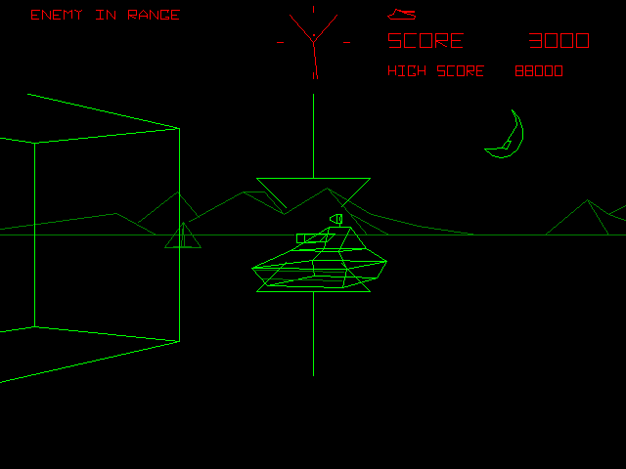
Q&A

